Slide 1
Searching And Sorting

Slide 2
SEARCHING

Slide 3
Searching
Two most commonly used techniques are:
  Linear Search
  Binary Search
Linear Search
  most simple technique
  data in the array can be in any order
  It traverse the whole array one by one to search a value
  O(n)
Binary Search
  efficient than the linear search
  O(logn)
  pre req: array mush be sorted

Slide 4
Linear Search
// if target is found, return index of target, // else return -1
int linearSearch(int a[], int size, int target)
{
for(int i=0;i<size;i++)
if(a[i] == target)
return i;
return -1;
}

Slide 5
Binary Search
Binary search. Given value and sorted array a[], find index i
such that a[i] = value, or report that no such index exists.
Ex. Binary search for 33.
6
13
14
25
33
43
51
53
64
72
84
93
95
96
97
0
1
2
3
4
5
6
7
8
9
10
11
12
13
14
lo
hi

Slide 6
Binary Search
Binary search. Given value and sorted array a[], find index i
such that a[i] = value, or report that no such index exists.
Ex. Binary search for 33.
6
13
14
25
33
43
51
53
64
72
84
93
95
96
97
0
1
2
3
4
5
6
7
8
9
10
11
12
13
14
lo
mid
hi

Slide 7
Binary Search
Binary search. Given value and sorted array a[], find index i
such that a[i] = value, or report that no such index exists.
Ex. Binary search for 33.
6
13
14
25
33
43
51
53
64
72
84
93
95
96
97
0
1
2
3
4
5
6
7
8
9
10
11
12
13
14
lo
hi

Slide 8
Binary Search
Binary search. Given value and sorted array a[], find index i
such that a[i] = value, or report that no such index exists.
Ex. Binary search for 33.
6
13
14
25
33
43
51
53
64
72
84
93
95
96
97
0
1
2
3
4
5
6
7
8
9
10
11
12
13
14
lo
mid
hi

Slide 9
Binary Search
Binary search. Given value and sorted array a[], find index i
such that a[i] = value, or report that no such index exists.
Ex. Binary search for 33.
6
13
14
25
33
43
51
53
64
72
84
93
95
96
97
0
1
2
3
4
5
6
7
8
9
10
11
12
13
14
lo
hi

Slide 10
Binary Search
Binary search. Given value and sorted array a[], find index i
such that a[i] = value, or report that no such index exists.
Ex. Binary search for 33.
6
13
14
25
33
43
51
53
64
72
84
93
95
96
97
0
1
2
3
4
5
6
7
8
9
10
11
12
13
14
lo
mid
hi

Slide 11
Binary Search
Binary search. Given value and sorted array a[], find index i
such that a[i] = value, or report that no such index exists.
Ex. Binary search for 33.
6
13
14
25
33
43
51
53
64
72
84
93
95
96
97
0
1
2
3
4
5
6
7
8
9
10
11
12
13
14
lo
hi

Slide 12
Binary Search
Binary search. Given value and sorted array a[], find index i
such that a[i] = value, or report that no such index exists.
Ex. Binary search for 33.
6
13
14
25
33
43
51
53
64
72
84
93
95
96
97
0
1
2
3
4
5
6
7
8
9
10
11
12
13
14
lo
hi
mid

Slide 13
Binary Search
Binary search. Given value and sorted array a[], find index i
such that a[i] = value, or report that no such index exists.
Ex. Binary search for 33.
6
13
14
25
33
43
51
53
64
72
84
93
95
96
97
0
1
2
3
4
5
6
7
8
9
10
11
12
13
14
lo
hi
mid

Slide 14
Binary search
binary search: Locates a target value in a sorted array/list by successively eliminating half of the array from consideration.
  How many elements will it need to examine? O(log N)
  Can be implemented with a loop or recursively
  Example: Searching the array below for the value 42:
index | 0 | 1 | 2 | 3 | 4 | 5 | 6 | 7 | 8 | 9 | 10 | 11 | 12 | 13 | 14 | 15 | 16
value | -4 | 2 | 7 | 10 | 15 | 20 | 22 | 25 | 30 | 36 | 42 | 50 | 56 | 68 | 85 | 92 | 103
min
mid
max

Slide 15
Binary search code
// Returns the index of an occurrence of target in a,
// or a negative number if the target is not found.
// Precondition: elements of a are in sorted order
int binarySearch(int a[], int size, int target)
{
int min = 0;
int max = size - 1;
while (min <= max)
{
int mid = (min + max) / 2;
if (a[mid] < target)
min = mid + 1;
else if (a[mid] > target)
max = mid - 1;
else
return mid; // target found
}
return -1; // target not found
}

Slide 16
Recursive binary search
Recursive binarySearch method.
  If the target value is not found, return its negative number
  int index = binarySearch(data,size, 42); // 10
  int index2 = binarySearch(data,size, 66); // -1
index | 0 | 1 | 2 | 3 | 4 | 5 | 6 | 7 | 8 | 9 | 10 | 11 | 12 | 13 | 14 | 15 | 16
value | -4 | 2 | 7 | 10 | 15 | 20 | 22 | 25 | 30 | 36 | 42 | 50 | 56 | 68 | 85 | 92 | 103

Slide 17
  // Returns the index of an occurrence of the given value in
  // the given array, or a negative number if not found.
  // Precondition: elements of a are in sorted order
  int Search(int[] a, int size, int target) {
  return binarySearch(a, target, 0, size - 1);
  }
  // Recursive function
  int binarySearch(int[] a, int target, int min, int max)
  {
  if (min > max)
  return -1; // target not found
  else
  {
  int mid = (min + max) / 2;
  if (a[mid] < target) //too small; go right
  return binarySearch(a, target, mid + 1, max);
  else if (a[mid] > target) // too large; go left
  return binarySearch(a, target, min, mid - 1);
  else
  return mid; // target found; a[mid] = = target
  }
  }

Slide 18
Animation:
https://www.cs.usfca.edu/~galles/visualization/Search.html
Reference
DS Malik
Chp16 page 1025 - 1028

Slide 19
Sorting
Mohammad Shahid Qureshi
Animation:
https://www.cs.usfca.edu/~galles/visualization/ComparisonSort.html

Slide 20
Sorting
The simplest algorithms usually take O(n²) time to sort n objects, and suited for sorting short lists.
  Selection sort
  Bubble sort
  Insertion sort
There are slightly more complicated algorithms available with good efficiency
  Quick sort
  Merge sort
  Heap sort
  Tree Sort

Slide 21
Bubble Sort
Lets cover one of the simplest technique to find its BigO

Slide 22
Bubble Sort
Also known as exchange sort
It works repeatedly stepping through the list to be sorted, comparing two items at a time and swapping them if they are in wrong order
For ascending order:
  Largest element will be at the last after 1st pass
  2nd largest will be at 2nd last after 2nd pass

Slide 23
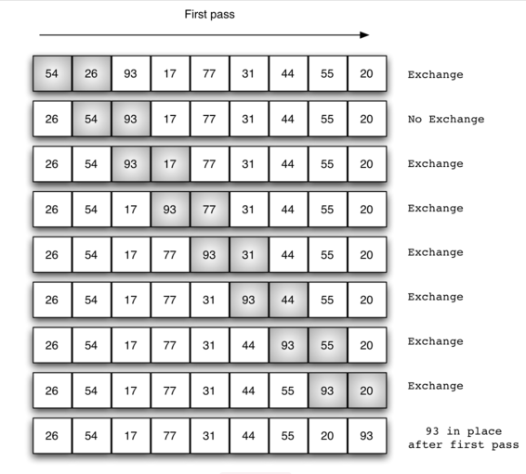
First pass

Slide 24
Example
Element | 1 | 2 | 3 | 4 | 5 | 6 | 7 | 8
Data | 27 | 63 | 1 | 72 | 64 | 58 | 14 | 9
1st pass | 27 | 1 | 63 | 64 | 58 | 14 | 9 | 72
2nd pass | 1 | 27 | 63 | 58 | 14 | 9 | 64 | 72
3rd pass | 1 | 27 | 58 | 14 | 9 | 63 | 64 | 72...
O(n²)

Slide 25
Analysis
void bubbleSort(int arr[], int n)
{
int i, j, temp;
for(i = 0; i < n; i++)
{
for(j = 0; j < n-i-1; j++)
{
if( arr[j] > arr[j+1])
{
// swap the elements
temp = arr[j];
arr[j] = arr[j+1];
arr[j+1] = temp;
}
}
}
}
How many swappings in one iteration of outer loop ??
(n-1) + (n-2) + …. +1+0

Slide 26
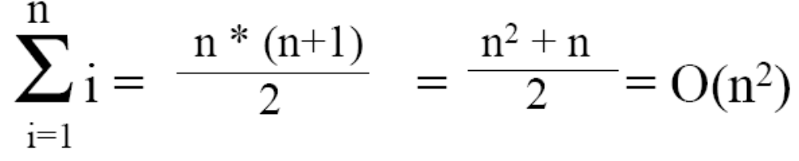
Analysis
(n-1) + (n-2) + …. +1+0
or
1 + 2 + 3 + ... + (n-1) + n
So sum of first n numbers is given as
What is the complexity of this?

Slide 27
Insertion Sort
Consists of N - 1 passes
For pass p = 1 through N - 1, ensures that the elements in positions 0 through p are in sorted order
  elements in positions 0 through p - 1 are already sorted
  move the element in position p left until its correct place is found among the first p + 1 elements

Slide 28
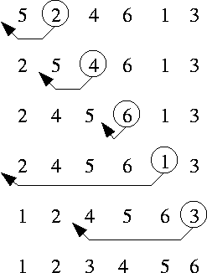
Insertion Sort
Animation: https://courses.cs.vt.edu/csonline/Algorithms/Lessons/InsertionCardSort/insertioncardsort.swf

Slide 29
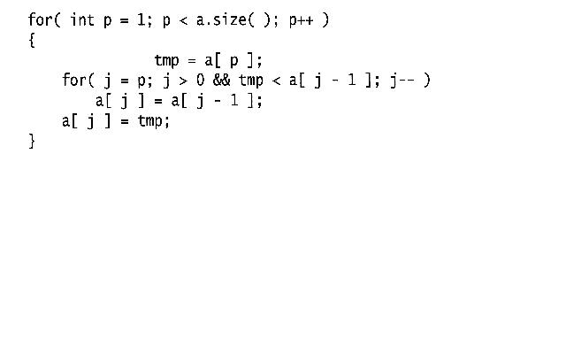
Algorithm

Slide 30
Extended Example
To sort the following numbers in increasing order:
34 8 64 51 32 21
P = 1; Look at first element only, no change.
P = 2; tmp = 8;
34 > tmp, so second element is set to 34.
We have reached the front of the list. Thus, 1st position = tmp
After second pass: 8 34 64 51 32 21
(first 2 elements are sorted)

Slide 31
P = 3; tmp = 64;
34 < 64, so stop at 3rd position and set 3rd position = 64
After third pass: 8 34 64 51 32 21
(first 3 elements are sorted)
P = 4; tmp = 51;
51 < 64, so we have 8 34 64 64 32 21,
34 < 51, so stop at 2nd position, set 3rd position = tmp,
After fourth pass: 8 34 51 64 32 21
(first 4 elements are sorted)
P = 5; tmp = 32,
32 < 64, so 8 34 51 64 64 21,
32 < 51, so 8 34 51 51 64 21,
next 32 < 34, so 8 34 34 51 64 21,
next 32 > 8, so stop at 1st position and set 2nd position = 32,
After fifth pass: 8 32 34 51 64 21
P = 6; tmp = 21, . . .
After sixth pass: 8 21 32 34 51 64

Slide 32
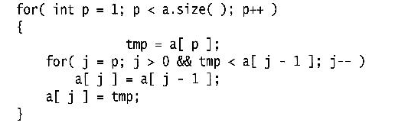
Analysis: worst-case running time
Inner loop is executed p times, for each p=1..N
⇒ Overall: O(N²)
Space requirement is O(N)

Slide 33
Selection Sort

Slide 34
Selection Sort
Given an array of length n,
  Search elements 0 through n-1 and select the smallest
    Swap it with the element in location 0
  Search elements 1 through n-1 and select the smallest
    Swap it with the element in location 1
  Search elements 2 through n-1 and select the smallest
    Swap it with the element in location 2
  Search elements 3 through n-1 and select the smallest
    Swap it with the element in location 3
  Continue in this fashion until there’s nothing left to search

Slide 35
Example and analysis of Selection Sort
For ascending order:
  Lowest element will be at 1st after 1st pass
  2nd lowest will be at 2nd location after 2nd pass
7
2
8
5
4
2
7
8
5
4
2
4
8
5
7
2
4
5
8
7
O(n²)
2
4
5
7
8

Slide 36
Code for Selection Sort
void selectionSort(int a[], int size)
{
int outer, inner, min;
for (outer = 0; outer < size; outer++)
{ // outer counts down
min = outer;
for (inner = outer + 1; inner < size; inner++)
{
if (a[inner] < a[min])
{
min = inner;
}
}
// a[min] is least among a[outer]..a[a.length - 1]
int temp = a[outer];
a[outer] = a[min];
a[min] = temp;
}
}

Slide 37
Divide-and-Conquer Sorting
Two great sorting methods are fundamentally divide-and-conquer
Quicksort:
  Pick a “pivot” element
  Divide elements into less-than pivot and greater-than pivot
  Sort the two divisions (recursively on each)
  Answer is: sorted-less-than....pivot....sorted-greater-than
Mergesort:
  Sort the left half of the elements (recursively)
  Sort the right half of the elements (recursively)
  Merge the two sorted halves into a sorted whole
CSE373: Data Structures & Algorithms

Slide 38
Quick Sort

Slide 39
Quick Sort
Quick Sort : Based on Divide and Conquer paradigm.
One of the fastest in-memory sorting algorithms (if not the fastest)
  is a very efficient sorting algorithm
  designed by C.A.R.Hoare in 1960.
Consists of two phases:
  Partition phase
  Sort phase

Slide 40
Steps...
1. Divide: Pick a pivot element and rearrange the array so that
- all elements to the left of the pivot are
smaller than the pivot.
- all elements to the right of the pivot are larger
than the pivot.
2. Conquer: Recursively quicksort the left and right subarrays.
3:Combine: since subarrays are sorted in place, no work is needed to combine them,array is now sorted.

Slide 41
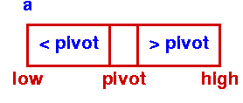
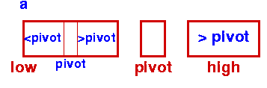
Quicksort
Initial Step - First Partition
Sort Left Partition in the same way

Slide 42
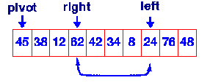
Quicksort – Partition phase
Steps:
  Select pivot value
  Move everything less than pivot value to the left of it
  Move everything greater than pivot value to the right of it

Slide 43
Algorithm: Quick Sort
Procedure QuickSort ( A, l, r )
if ( r > l ) then
j ← partition ( A, l, r );
QuickSort ( A, l, j - 1 );
QuickSort ( A, j + 1 , r );
end of if.

Slide 44
l
r
A
9 8 2 3 88 34 5 10 11 0
Partition
A
5 8 2 3 0 9 34 11 10 88
l
j
r

Slide 45
Algorithm: Partition
Function Partition (A, l, r )
v ← a[ l ]; i ← l ; j ← r;
while i<j
while (A[i]<=v && i<r)
i++;
while (A[j]>v )
j--;
if (i<j) then swap (a[ i ], a[ j ]);
A [ l ] = a[ j ]; a[ j ] ← v;
return ( j );
There are various algorithms for partition.
Above Algorithm is the most popular. This is because it does
not need an extra array. Only 3 variables v,i, and j.

Slide 46
v = a[ l ]; i = l ; j = r;
while i<j
while (A[i]<=v && i<r) i++;
while (A[j]>v ) j--;
if (i<j) then swap (a[ i ], a[ j ]);
A [ l ] = a[ j ]; a[ j ] = v;
return ( j );
v
9
i
j
9 8 2 3 88 34 5 10 11 0
i
j
9 8 2 3 88 34 5 10 11 0
i
j
9 8 2 3 0 34 5 10 11 88
i
j
9 8 2 3 0 34 5 10 11 88

Slide 47
v = a[ l ]; i = l ; j = r;
while i<j
while (A[i]<=v && i<r) i++;
while (A[j]>v ) j--;
if (i<j) then swap (a[ i ], a[ j ]);
A [ l ] = a[ j ]; a[ j ] = v;
return ( j );
i
j
9 8 2 3 0 5 34 10 11 88
j
i
out of outer
while loop
9 8 2 3 0 5 34 10 11 88
j
i
5 8 2 3 0 9 34 10 11 88

Slide 48
Procedure QuickSort ( A, l, r )
if ( r > l ) then
j ← partition ( A, l, r );
QuickSort ( A, l, j - 1 );
QuickSort ( A, j + 1 , r );
end of if.
j
i
5 8 2 3 0 9 34 10 11 88
5 8 2 3 0
34 10 11 88

Slide 49
v = a[ l ]; i = l ; j = r;
while i<j
while (A[i]<=v && i<r) i++;
while (A[j]>v ) j--;
if (i<j) then swap (a[ i ], a[ j ]);
A [ l ] = a[ j ]; a[ j ] = v;
return ( j );
v
5
i
j
5 8 2 3 0
i
j
5 8 2 3 0
i
j
swap
5 0 2 3 8
j
i
5 0 2 3 8

Slide 50
v = a[ l ]; i = l ; j = r;
while i<j
while (A[i]<=v && i<r) i++;
while (A[j]>v ) j--;
if (i<j) then swap (a[ i ], a[ j ]);
A [ l ] = a[ j ]; a[ j ] = v;
return ( j );
j
i
3 0 2 5 8

Slide 51
Time Complexity
So time complexity is O(nlogn)
  O(n) work is required to partition at each of log n levels of recursion
  Number of comparisons performed for all partitions
    n + 2(n/2) + 4 (n/4) + 8(n/8) + … + n(n/n) = n( logn +1)
    Which is O(nlogn)

Slide 52
Drawback of QuickSort
In cases, in which data is very nearly in the correct order, the partitions will be very unequal in size
  It will cause the number of levels of recursion to approach N rather log N, resulting in O(N²)

Slide 53
The worst case is when the input is already sorted.
1 2 3 4 5 6 7 8
1 2 3 4 5 6 7 8
1 2 3 4 5 6 7 8
1 2 3 4 5 6 7 8
1 2 3 4 5 6 7 8
1 2 3 4 5 6 7 8
1 2 3 4 5 6 7 8
1 2 3 4 5 6 7 8

Slide 54
Solution
Randomize the input data before giving it to Quick Sort.
OR
In the partition phase, rather than choosing first value to be the pivot value, choose a RANDOM value to be pivot value.
This makes Quick Sort run time independent of input ordering
So Worst case won’t happen for SORTED inputs but may only happen by worseness of random number generator.

Slide 55
Animation
http://me.dt.in.th/page/Quicksort/

Slide 56
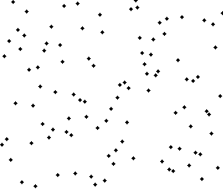
Animation

Slide 57
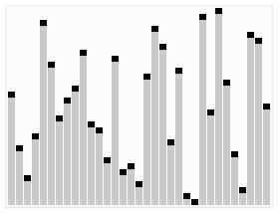
Another animation

Slide 58
MERGE SORT

Slide 59
Merge Sort
Divide: Split array roughly into half
Unsorted
Unsorted
Unsorted
Conquer: Return array when length ≤ 1
Combine: Combine two sorted arrays using merge
Sorted
Sorted
Sorted

Slide 60
Merge Sort:
Core idea: split array in half, sort each half, merge back together. If the array has size 0 or 1, just return it unchanged

Slide 61
Merge Sort Example
7
2
8
4
5
3
1
6
7
2
8
4
5
3
1
6
7
2
8
4
5
3
1
6
7
2
8
4
5
3
1
6

Slide 62
Merge Sort Example
1
2
3
4
5
6
7
8
2
4
7
8
1
3
5
6
2
7
4
8
3
5
1
6
7
2
8
4
5
3
1
6

Slide 63
Merge Example
Merge operation: Use 3 indexes and 1 more array
First half after sort:
Second half after sort:
2
4
7
8
1
3
5
6
Result:
Notes:
We’re going to use three fingers here. One to keep track of our index in the left half, one right half, one new array.

Slide 64
Merge Example
Merge operation: Use 3 pointers and 1 more array
First half after sort:
Second half after sort:
2
4
7
8
1
3
5
6
Result:
1
Notes:
We’re going to use three fingers here. One to keep track of our index in the left half, one right half, one new array.

Slide 65
Merge Example
Merge operation: Use 3 pointers and 1 more array
First half after sort:
Second half after sort:
2
4
7
8
1
3
5
6
Result:
1
2
Notes:
We’re going to use three fingers here. One to keep track of our index in the left half, one right half, one new array.

Slide 66
Merge Example
Merge operation: Use 3 pointers and 1 more array
First half after sort:
Second half after sort:
2
4
7
8
1
3
5
6
Result:
1
2
3
Notes:
We’re going to use three fingers here. One to keep track of our index in the left half, one right half, one new array.

Slide 67
Merge Example
Merge operation: Use 3 pointers and 1 more array
First half after sort:
Second half after sort:
2
4
7
8
1
3
5
6
Result:
1
2
3
4
Notes:
We’re going to use three fingers here. One to keep track of our index in the left half, one right half, one new array.

Slide 68
Merge Example
Merge operation: Use 3 pointers and 1 more array
First half after sort:
Second half after sort:
2
4
7
8
1
3
5
6
Result:
1
2
3
4
5
Notes:
We’re going to use three fingers here. One to keep track of our index in the left half, one right half, one new array.

Slide 69
Merge Example
Merge operation: Use 3 pointers and 1 more array
First half after sort:
Second half after sort:
2
4
7
8
1
3
5
6
Result:
1
2
3
4
5
6
Notes:
We’re going to use three fingers here. One to keep track of our index in the left half, one right half, one new array.

Slide 70
Merge Example
Merge operation: Use 3 pointers and 1 more array
First half after sort:
Second half after sort:
2
4
7
8
1
3
5
6
Result:
1
2
3
4
5
6
7
Notes:
We’re going to use three fingers here. One to keep track of our index in the left half, one right half, one new array.

Slide 71
Merge Example
Merge operation: Use 3 pointers and 1 more array
First half after sort:
Second half after sort:
2
4
7
8
1
3
5
6
Result:
1
2
3
4
5
6
7
8
After Merge: copy result into original unsorted array.
Or you can do the whole process in-place, but it’s more difficult to write
Notes:
We’re going to use three fingers here. One to keep track of our index in the left half, one right half, one new array.

Slide 72
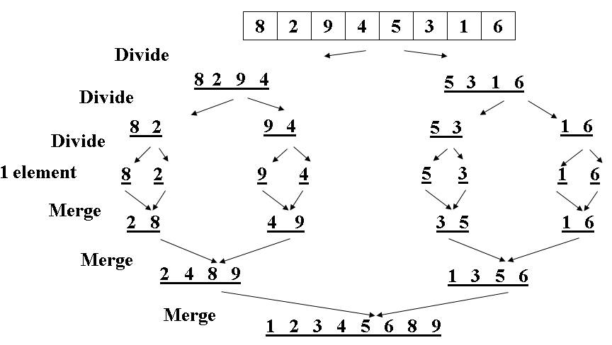
Merge Sort Analysis
Runtime:
  subdivide the array in half each time: O(log(n)) recursive calls
  merge is an O(n) traversal at each level
So, the best and worst case runtime is the same: O(n log(n))
O(log(n)) levels

Slide 73
IMPLEMENTATION
http://www.cdn.geeksforgeeks.org/merge-sort/

Slide 74
/* l is for left index and r is right index of the
sub-array of arr to be sorted */
void mergeSort(int arr[], int l, int r)
{
if (l < r)
{
// Same as (l+r)/2, but avoids overflow for
// large l and h
int m = l+(r-l)/2;
// Sort first and second halves
mergeSort(arr, l, m);
mergeSort(arr, m+1, r);
merge(arr, l, m, r);
}
}

Slide 75
// Merges two subarrays of arr[].
// First subarray is arr[l..m]
// Second subarray is arr[m+1..r]
void merge(int arr[], int l, int m, int r)
{
int i, j, k;
int n1 = m - l + 1;
int n2 = r - m;
/* create temp arrays */
int L[n1], R[n2];
/* Copy data to temp arrays L[] and R[] */
for (i = 0; i < n1; i++)
L[i] = arr[l + i];
for (j = 0; j < n2; j++)
R[j] = arr[m + 1+ j];
/* Merge the temp arrays back into arr[l..r]*/
i = 0; // Initial index of first subarray
j = 0; // Initial index of second subarray
k = l; // Initial index of merged subarray

Slide 76
while (i < n1 && j < n2)
{
if (L[i] <= R[j]) {
arr[k] = L[i];
i++;
}
else {
arr[k] = R[j];
j++;
}
k++;
}
/* Copy the remaining elements of L[], if there
are any */
while (i < n1)
{
arr[k] = L[i];
i++;
k++;
}

Slide 77
/* Copy the remaining elements of R[], if there
are any */
while (j < n2)
{
arr[k] = R[j];
j++;
k++;
}
}

Slide 78
Heap Sort

Slide 79
Heap sort
We can even use the heap to do the sorting
Method
  Given any data, first heapify it
  Then successively call the delete_max function on this heap till the heap is empty
    Keep on placing the deleted data in the array from end to start to get sorted data

Slide 80
Another kind of heap
Max_heap
  Parent has higher value than its children
  Therefore the root has the highest value

Slide 81
How to build a heap?
Build_heap
  Also known as heapify
  Start from the second last level, and check the condition of heap by comparing it with its children
  If needs arise swap the values

Slide 82
Example: building a max_heap (1)
1 2 3 4 5 6 7 8 9 10
1
4 | 1 | 3 | 2 | 16 | 9 | 10 | 14 | 8 | 7
4
2
3
1
3
4
5
6
7
2
16
9
10
8
9
10
14
8
7

Slide 83
Example: building a heap (2)
1
4
2
3
1
3
4
5
6
7
2
16
9
10
8
9
10
14
8
7

Slide 84
Example: building a heap (4)
1
4
2
3
1
3
4
5
6
7
14
16
9
10
8
9
10
2
8
7

Slide 85
Example: building a heap (5)
1
4
2
3
1
10
4
5
6
7
14
16
9
3
8
9
10
2
8
7

Slide 86
Example: building a heap (6)
1
4
2
3
16
10
4
5
6
7
14
7
9
3
8
9
10
2
8
1

Slide 87
Example: building a heap (7)
1
16
2
3
14
10
4
5
6
7
8
7
9
3
8
9
10
2
4
1

Slide 88
Heapsort
Heapsort(A)
1. Build-Max-Heap(A)
2. for i ← length[A] down to 2
3. A[i] ← Delete_Max( )
Keep in mind that the largest element is at the root.
Delete_Max() is O(lg n), but is executed n times,
so runtime for Heapsort(A) is
O(nlgn) for all Delete_Max and
O(nlgn) for Build_Max_Heap
Total O(nlgn)

Slide 89
Example: Heap-Sort
1
16
2
3
14
10
4
5
6
7
8
7
9
3
8
9
10
2
4
1
16 | 14 | 10 | 8 | 7 | 9 | 3 | 2 | 4 | 1

Slide 90
Example: Heap-Sort (2)
1
14
2
3
8
10
4
5
6
7
4
7
9
3
8
9
10
2
1
16
16 | 8 | 10 | 4 | 7 | 9 | 3 | 2 | 1 | 16

Slide 91
Example: Heap-Sort (3)
1
10
2
3
8
9
4
5
6
7
4
7
1
3
8
9
10
2
14
16
10 | 8 | 9 | 4 | 7 | 1 | 3 | 2 | 14 | 16

Slide 92
Example: Heap-Sort (4)
1
9
2
3
8
3
4
5
6
7
4
7
1
2
8
9
10
10
14
16
9 | 8 | 3 | 4 | 7 | 1 | 2 | 10 | 14 | 16

Slide 93
Example: Heap-Sort (4)
1
8
2
3
7
3
4
5
6
7
4
2
1
9
8
9
10
10
14
16
8 | 7 | 3 | 4 | 2 | 1 | 9 | 10 | 14 | 16

Slide 94
Example: Heap-Sort (5)
1
7
2
3
4
3
4
5
6
7
1
2
8
9
8
9
10
10
14
16
7 | 4 | 3 | 1 | 2 | 8 | 9 | 10 | 14 | 16

Slide 95
Example: Heap-Sort (6)
1
4
2
3
2
3
4
5
6
7
1
7
8
9
8
9
10
10
14
16
4 | 2 | 3 | 1 | 7 | 8 | 9 | 10 | 14 | 16

Slide 96
Example: Heap-Sort (7)
1
3
2
3
2
1
4
5
6
7
4
7
8
9
8
9
10
10
14
16
3 | 2 | 1 | 4 | 7 | 8 | 9 | 10 | 14 | 16

Slide 97
Example: Heap-Sort (8)
1
2
2
3
1
3
4
5
6
7
4
7
8
9
8
9
10
10
14
16
2 | 1 | 3 | 4 | 7 | 8 | 9 | 10 | 14 | 16

Slide 98
Data is now sorted
1 | 2 | 3 | 4 | 7 | 8 | 9 | 10 | 14 | 16

Slide 99
Reference
Section 6.1, 6.2 & 6.3 of
  Data Structures and Algorithm Analysis in C++
    by Mark Allen Weiss

Slide 100
Tree Sort
Save data in a BST
Do inorder traversal to get sorted data
O( ) ??
O(nlgn) for creating BST
And O(n) for inorder traversal
So Total O(nlgn)

